Slide 1


-----Bejeweled Game
Project members:
17301089 曹泽麟
17301119 昌凯枫
17301117 周洲游
17301114 张永泰
17301063 胡志禹

Slide 2
Github:
https://github.com/hg-hg/2019-BattleBlocks.git
Comments are welcome

Slide 3
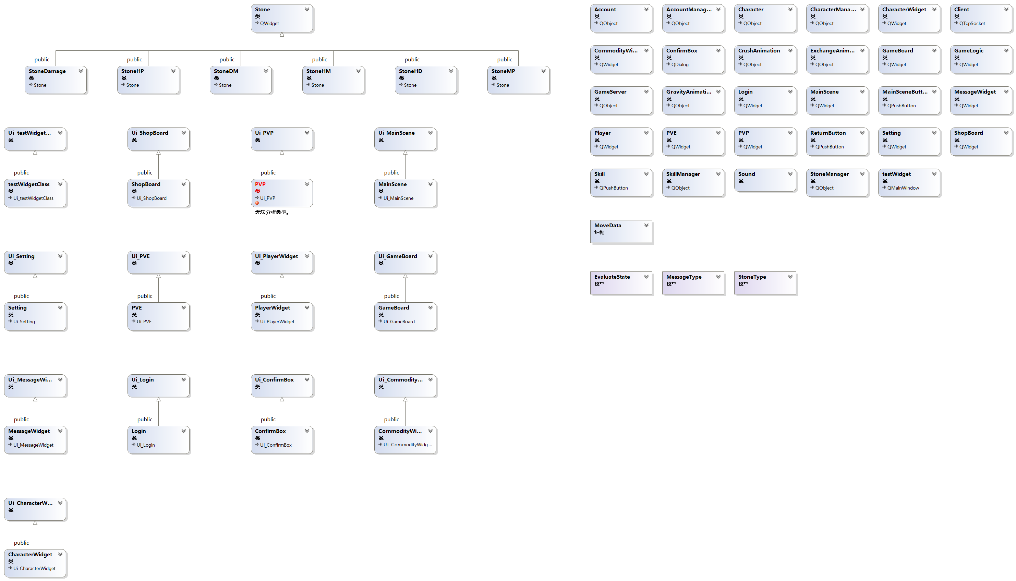
Class Diagram:

Slide 4
Project Characteristics:
1.Management
2.Resource
3.Game content

Slide 5
1.Management
Collaborative work
IDE
Progress Synchronization
Git
VS code
VS 2017
QT

Slide 6
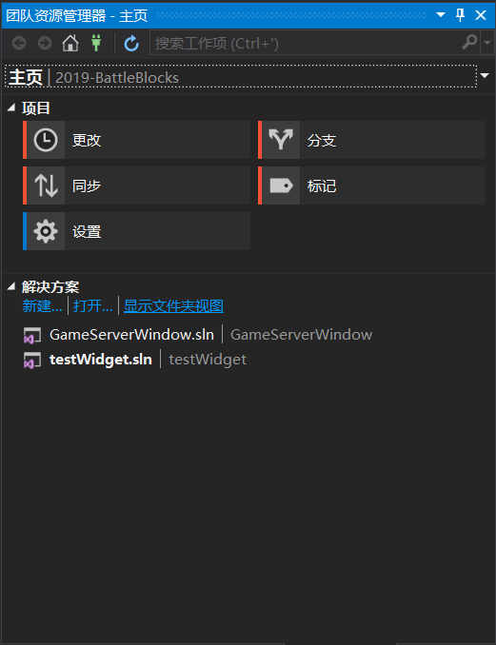
1.Management

Slide 7
1.Management
Progress monitoring
Information update
Github

Slide 8
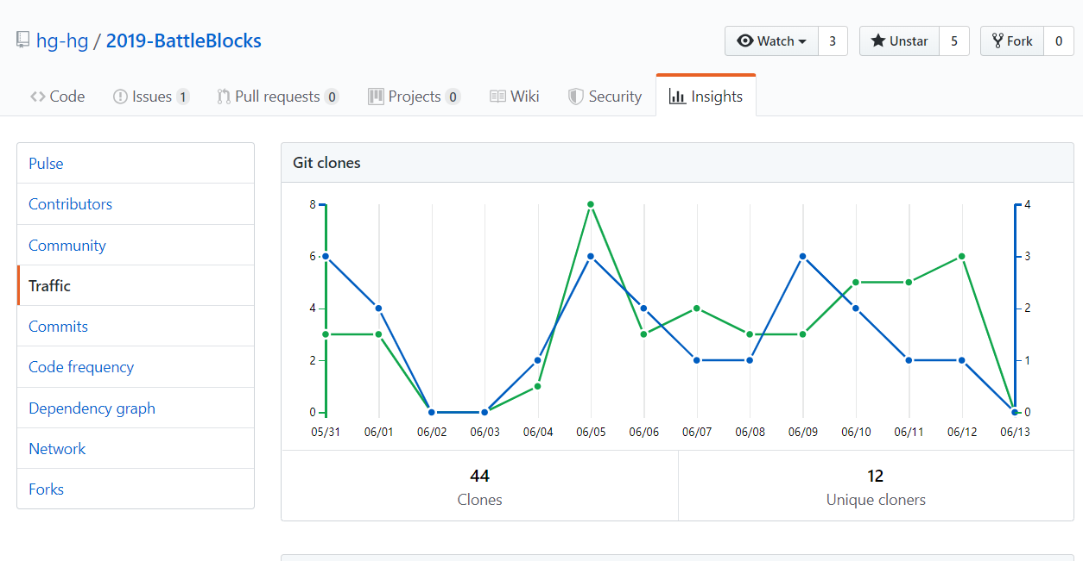
1.Management

Slide 9
2.Resource
CC0 License
Freeing content globally without restrictions

Slide 10
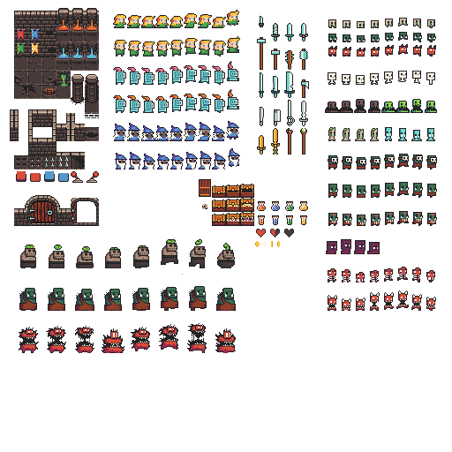
2.Resource
Thanks to:
0x72.itch.io

Slide 11

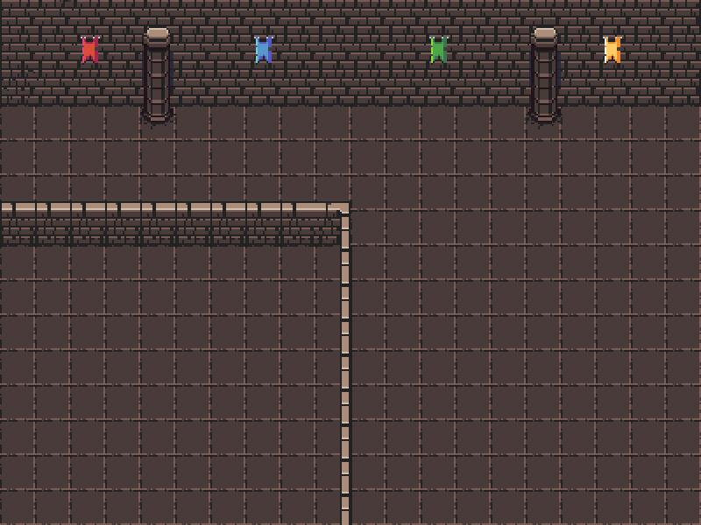



2.Resource
Font, Music & Sound Effect

Slide 12
3.Game content

Slide 13
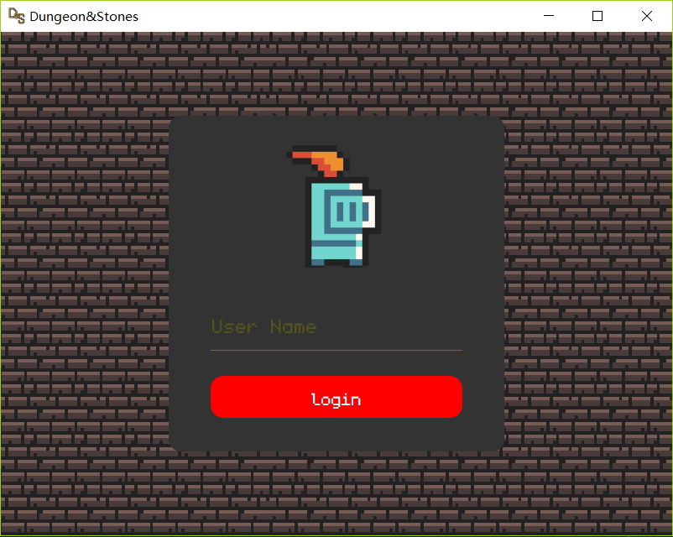
Log in scene

Slide 14
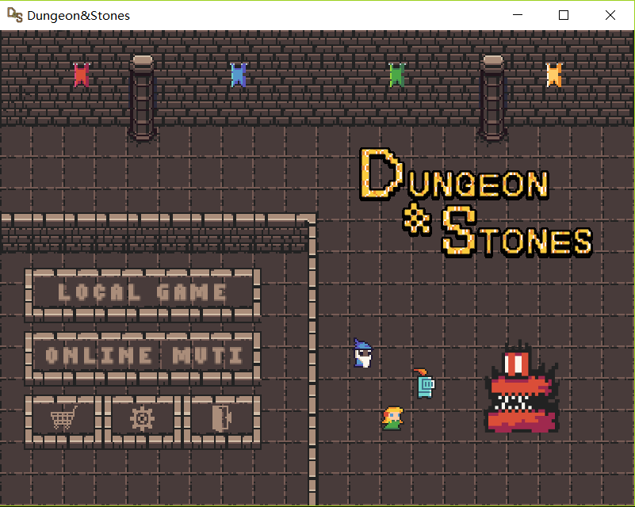
Main scene
Single player
Multiple player
Shop
Setting

Slide 15
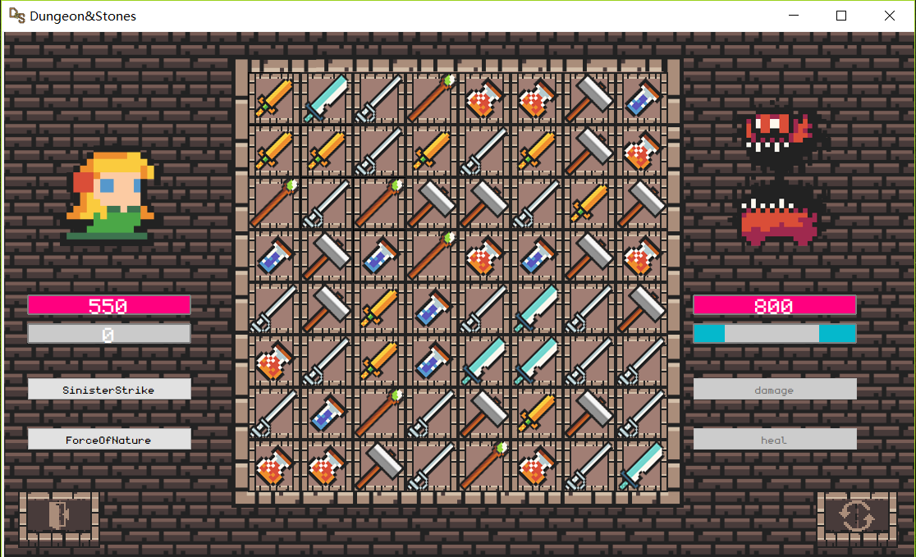
Game board
Player HP
Enemy HP
Player MP
Skill 1
Skill 2
Escape
Refresh
Stones

Slide 16
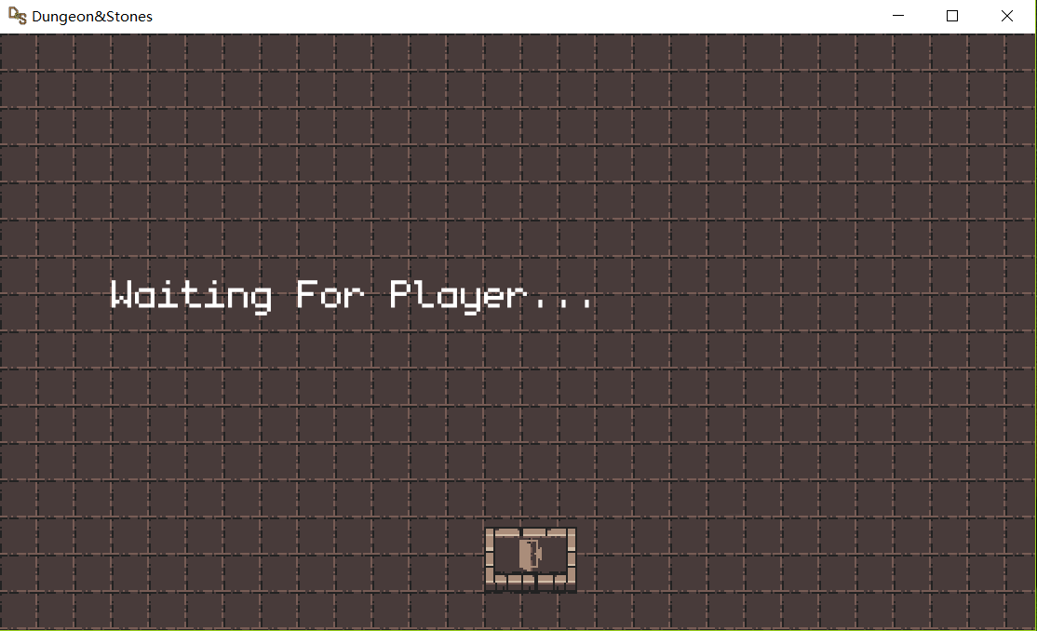
Online game

Slide 17
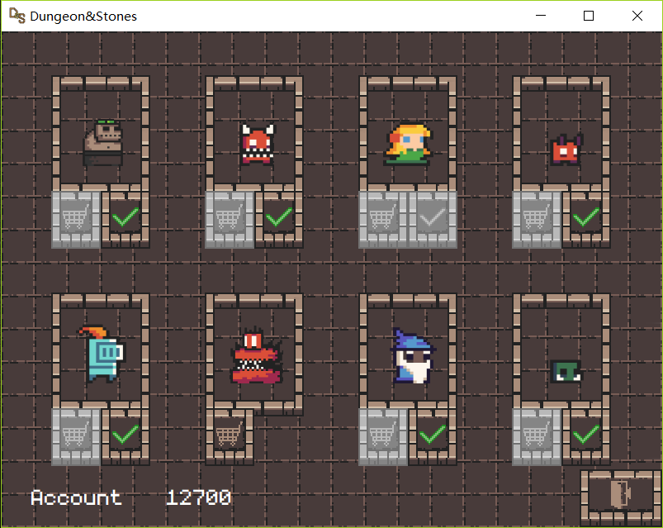
Shop

Slide 18
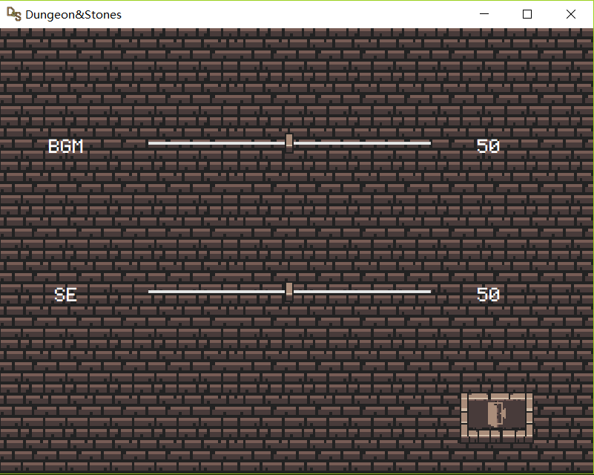
Setting

Slide 19
3.Game content
Stones
Features
Character
Skill
Multiple battle

Slide 20






Stones
Damage taking
HP recovery
MP recovery
MP recovery
(As timer)
(as skill cost)

Slide 21







Character

Slide 22
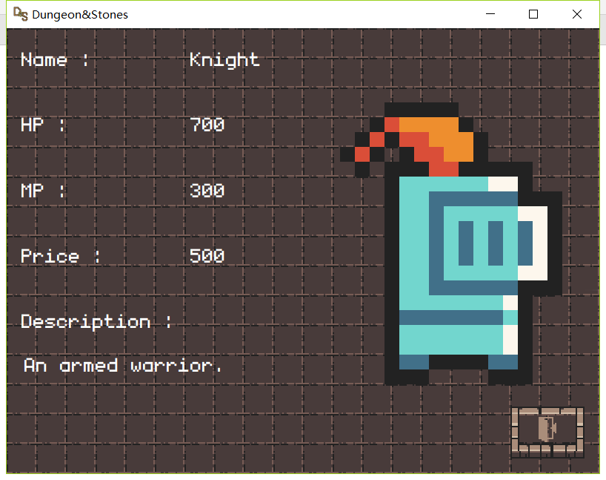
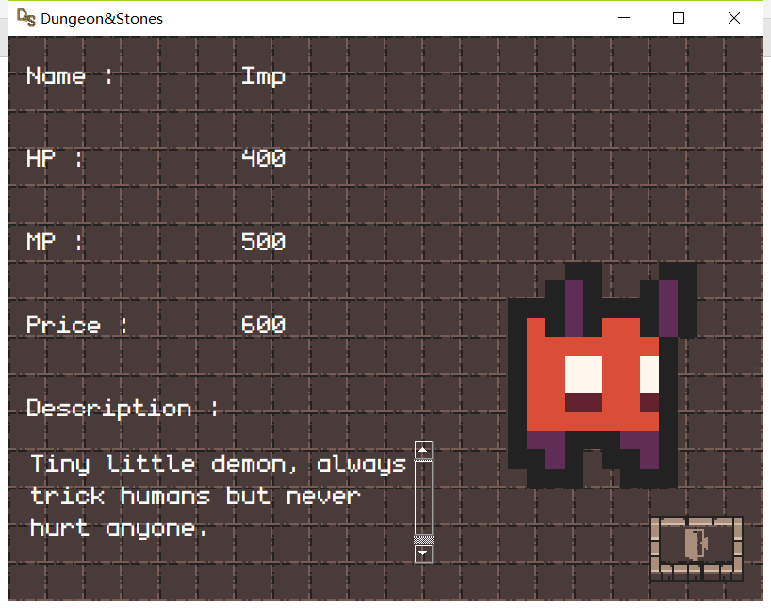
Character
Different

Slide 23
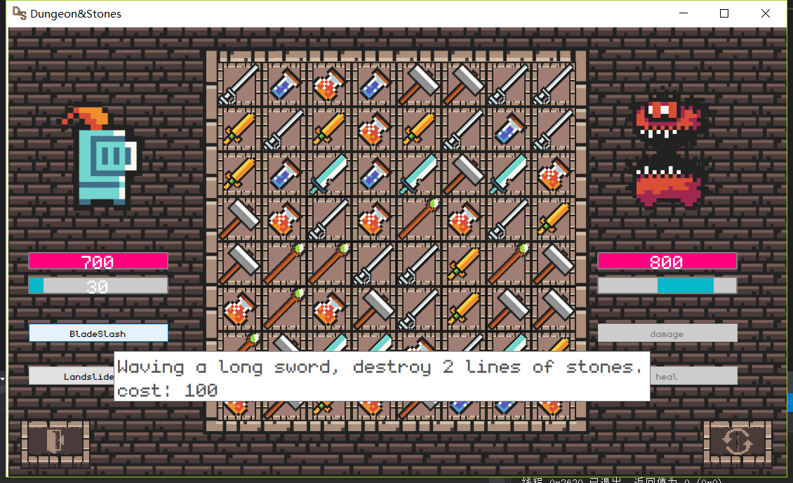
Character
Skill

Slide 24
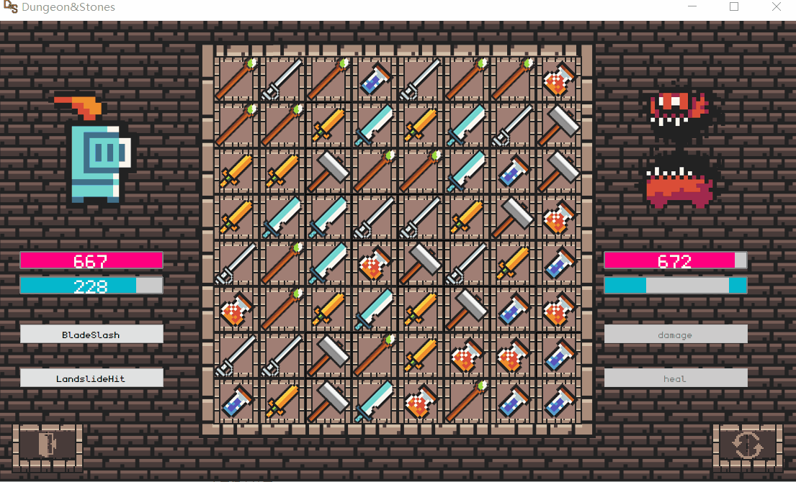
Skill

Slide 25
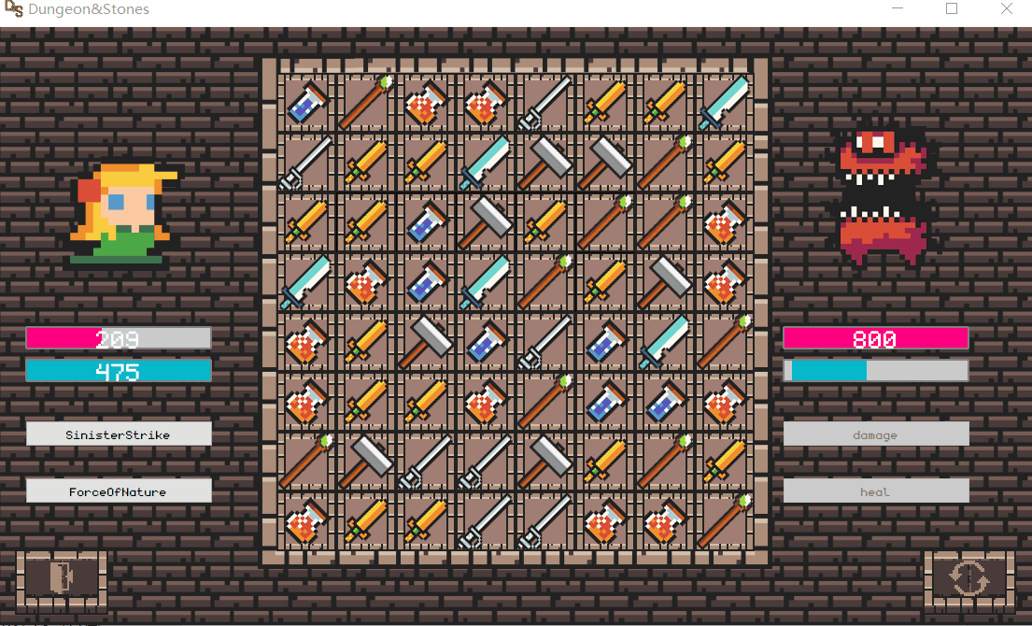
Skill

Slide 26
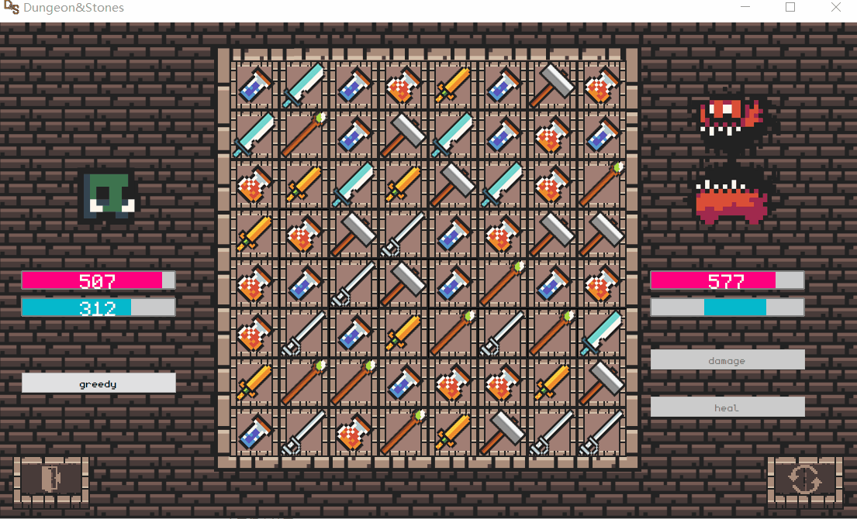
Skill

Slide 27
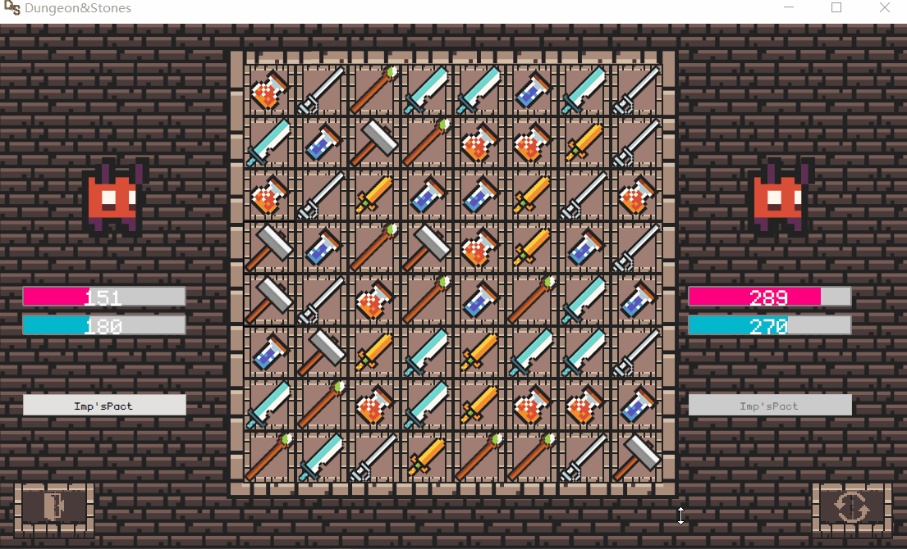
Skill

Slide 28
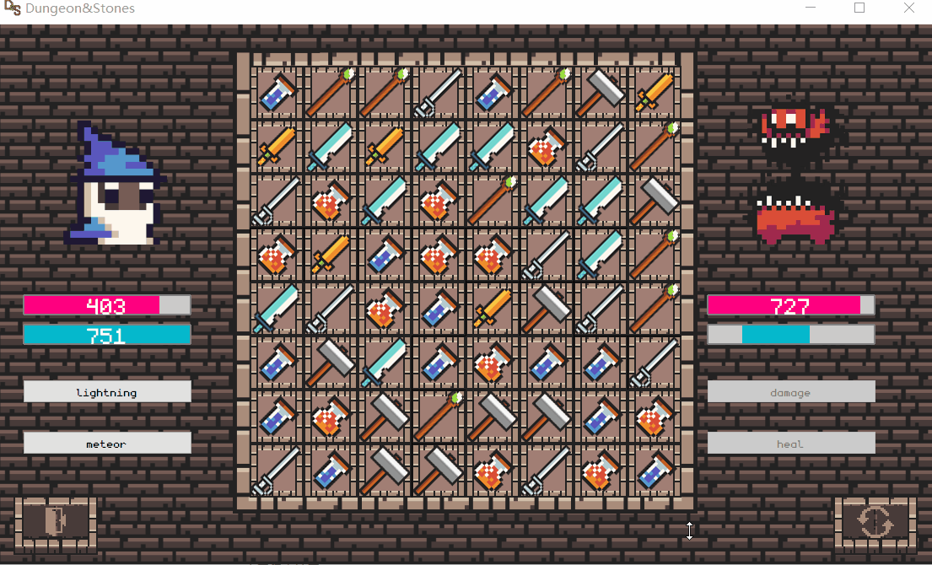
Skill

Slide 29
Multiple battle
Please watch the demonstration

Slide 30
Thanks for watching
Wish you enjoy the game

